Slide 1
Coder Dojo
Adding an external mod to Minecraft
Object Oriented Programming
Graphic Design

Slide 2
Adding Mods
The launcher way:
Tekkit or Feed the Beast
Manually
Merging jars

Slide 3
The Abstract
What does Abstract mean?
Exists in thought, not in physical form
Our knowledge of programming and java is like our knowledge of the US
We may know what the US looks like, the states, what our roads look like, but there is also much we don't know
It's ok, we can learn!

Slide 4
Programming with Objects
Ultimately about readability and code reuse
In Procedural Progarmming you can only use the tools the language gives you (loops, variables, functions, etc).
BASIC is procedural: we can do cool stuff, but large programs might be hard to make!
In Object Oriented programming we create our own tools (using existing tools)!
Let's make a car! What do cars have?

Slide 5
Inheritance
Inheritance is one important feature about Object Oriented programming
What are some specific types of cars?
In Minecraft we're going to create our own blocks which will inherit abilities from the object Block

Slide 6
Objects in Java
Classes are Objects!
Remember: classes have methods and variables
Methods do stuff
Variables hold information
In Java we show inheritance with the word “extends”
public class MyBlock extends Block

Slide 7
Our Custom Block
public class MyBlock extends Block {
public MyBlock(int id, Material material) {
super(id, material);
}
@Override
public void registerIcons(IconRegister iconRegister) {
this.blockIcon = iconRegister.registerIcon("BaseMod:test");
}
}

Slide 8
Adding Flair to our Block
public final static Block myBlock = new MyBlock(500, Material.ground)
.setHardness(0.5F)
.setStepSound(Block.soundMetalFootstep)
.setUnlocalizedName("myBlock")
.setCreativeTab(CreativeTabs.tabBlock)
.setLightValue(0.0F)
.setLightOpacity(0);

Slide 9




Graphics
There are MANY image editors (some good free ones too!)
Try a few and use your favorite!

Slide 10
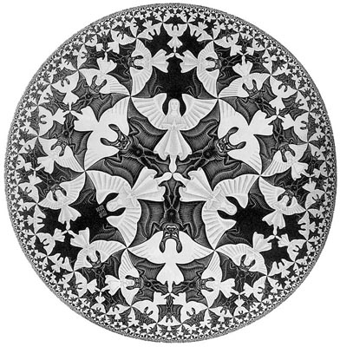
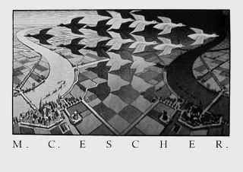
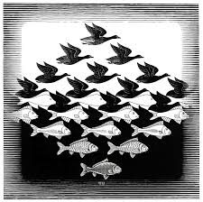
Tessellations

Slide 11
Creating your own block
There are only two rules:
Your image must be 16 pixels by 16 pixels
Your image must be saved in the PNG format in forge/mcp/src/minecraft/mods/BaseMod/textures/blocks/
Additionally you may want to turn on the Grid if your image program supports it

Slide 12
Experiment!
Edit MyBlock
Change it's properties
Change the image used
Break it
Fix it
Explore
Share!

